Slide 1
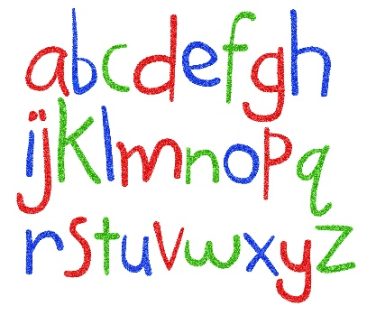
Phonics Biography
My name is Mrs Mauger and I was absolutely thrilled to be appointed the new phonics lead at Hanbury’s Farm Primary School.
Since starting my teaching career 18 years ago, phonics and early reading has always been a passion of mine. Watching children go from reading sounds, to words, to sentences, to full texts still amazes me after all these years. The excitement on their faces as they are able to sound out words for the first time or the first time they can read their favourite book for themselves.
As a child, I remember the wonderful feeling of learning to read and sharing books with my family. Now having my own children, supporting them in their own reading journeys is just as exciting.
I really hope that all the children at Hanbury’s Farm Primary School develop a love of sounds, words and reading, so that their worlds can be opened up to so many adventures.

